Slide 1

ENSEMBLES OF ARIMA AND ARIMAX FOR FLU FORECASTING IN THE CONTIGUOUS U.S.

Slide 2
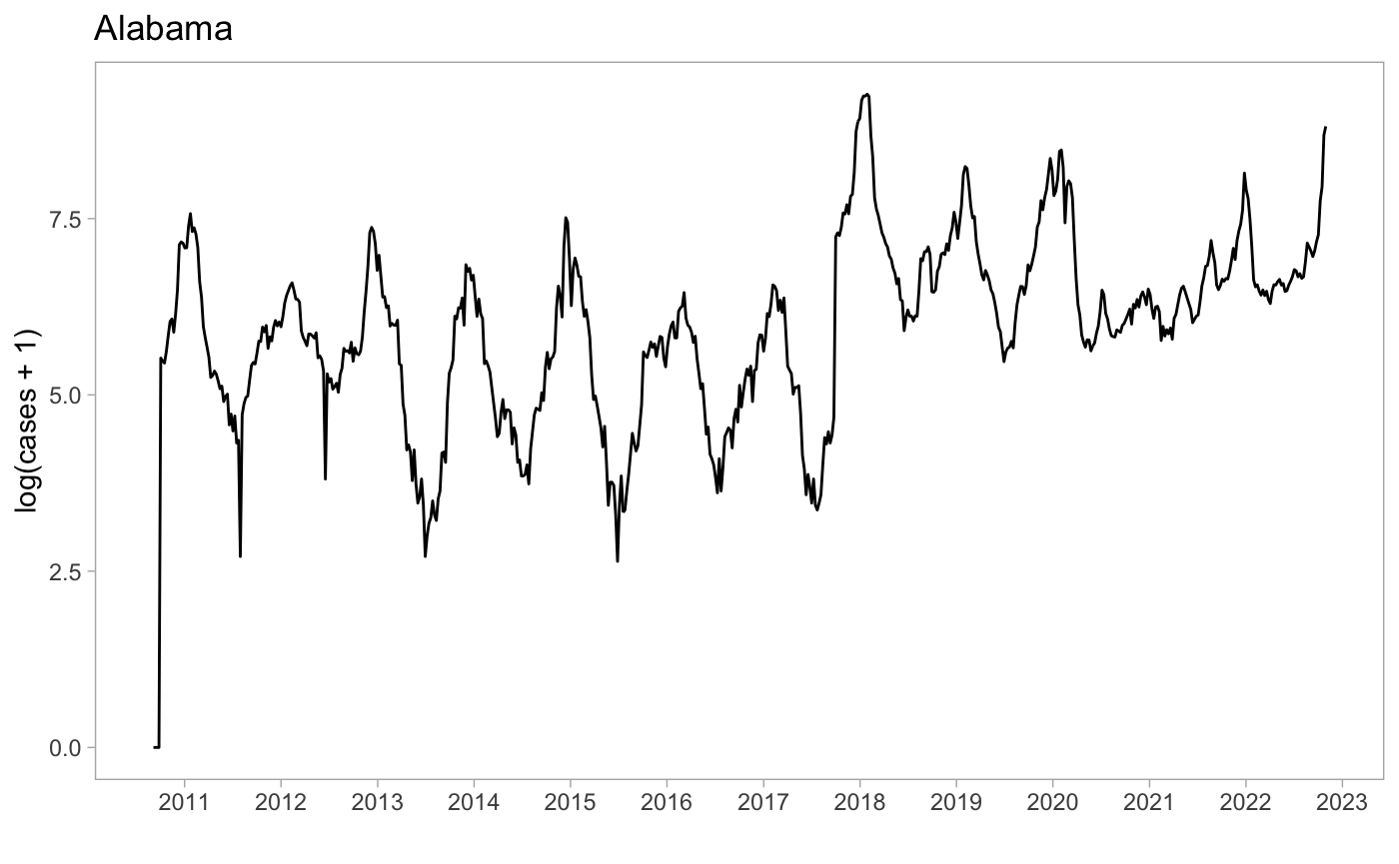
ARIMA ROLLING WINDOW
Rolling window – 104 weeks
We fit 2 years of log(Flu Cases+1) to train multiple models using CDC’s over 10 years FluView dataset.
f3
. . .
N
f2
f530
f1
f529

Slide 3
ARIMAX MODEL FITTING WITH 1 WEEK-LAG
To forecast N weeks ahead we fit a 2 years rolling window of exogenous variables with 1 week-lag. This is done because when we run the ARIMAX model we need an exogenous variable that will help to guide the forecasts. This fitting process try to use a possible relationship between exogenous variables in the previous week and the IILI cases in the current week. The goal is to have a model in which we can ask: for a given temperature, or mean cases by epidemiological week, or mean cases in adjacent states in the current week, what would be the number of flu cases in the next week?
EPIWEEK ADJACENT STATES TEMPERATURE
ILI DATA ILI DATA ILI DATA
1+n
104 + n
1+n
104 + n
1+n
104 + n
2+n
105 + n
2+n
105 + n
2+n
105 + n
For n in (1:number_of_ILI_weeks – 104)

Slide 4
CREATING THE ARIMAX EXOGENOUS VARIABLES
EPIWEEK
<- (ILI_cases[1:52]+ILI_cases[53:104])/2
Mean cases by epidemiological weeks
1
104
1
52
53
104
1
104
3
. . .
N
2
595
1
694

Slide 5
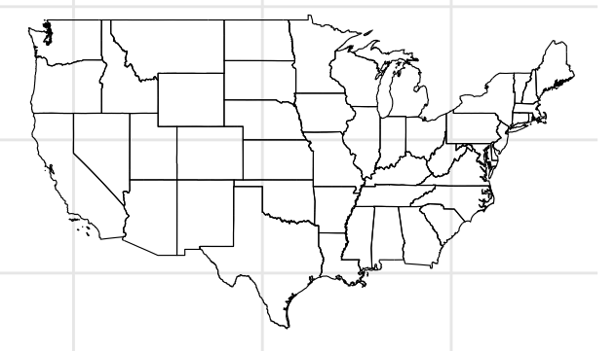
CREATING THE ARIMAX EXOGENOUS VARIABLES
ADJACENT STATES MEAN ILI CASES
<- mean( )
Mean cases by adjacent states
Adjacent state A
1
104
1
104
Adjacent state B
1
104
Adjacent state C
1
104
Adjacent state D
1
104

Slide 6
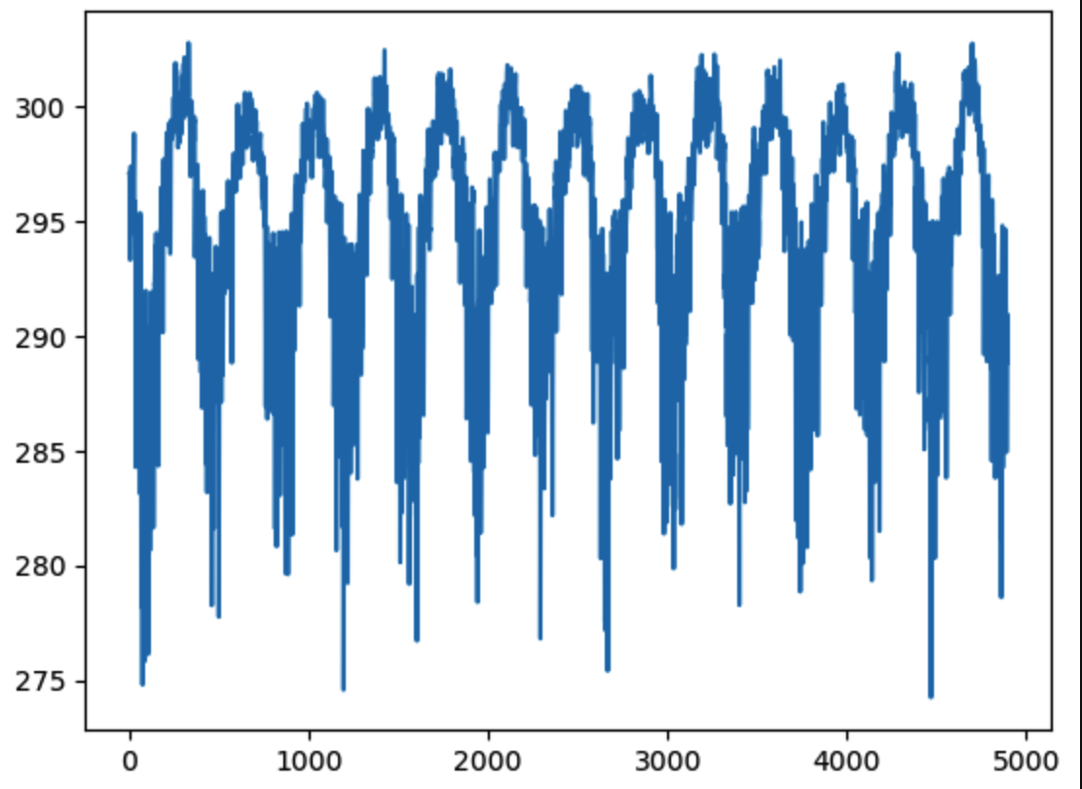
CREATING THE ARIMAX EXOGENOUS VARIABLES
TEMPERATURE
Temperature 104 weeks
1
104
Mean weekly temperature by each state in kelvins using the ERA5 dataset

